Slide 1
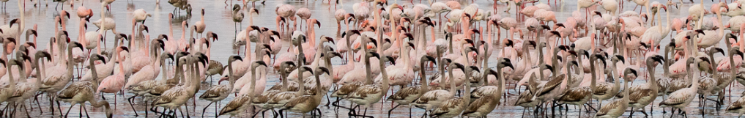



BIRDIE wetlands and waterbirds data pipeline: from data to decision making
Pachi Cervantes, Francis Strobbe
Symposium on Biodiversity Informatics
November 2022
Stellenbosch, South Africa

Slide 2
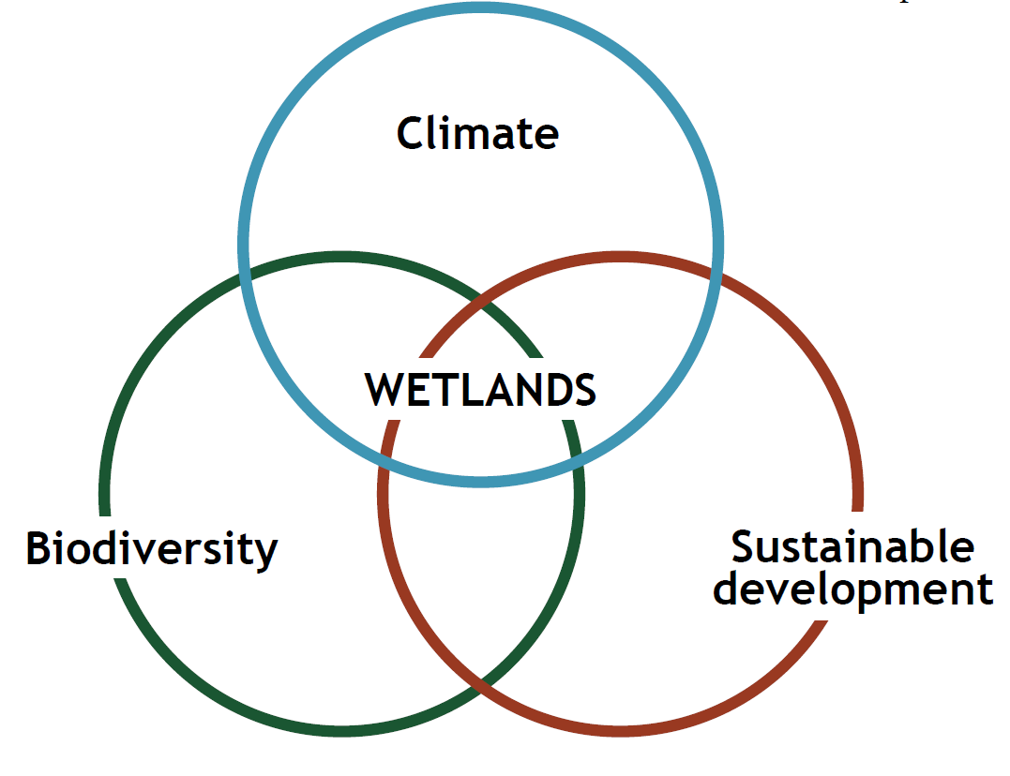
A data pipeline for wetlands and waterbirds
Convention on Wetlands. (2021). Global Wetland Outlook: Special Edition 2021

Slide 3
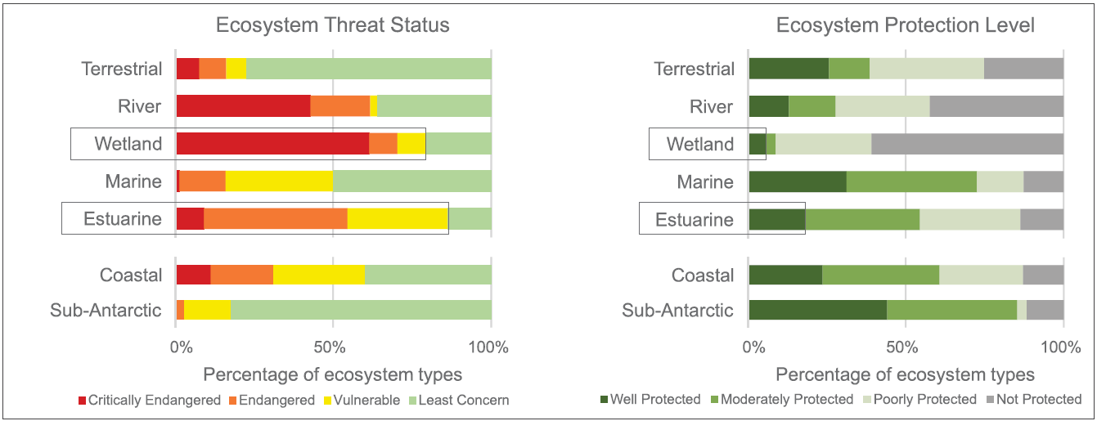
A data pipeline for wetlands and waterbirds
South African National Biodiversity Institute (SANBI). 2019. National Biodiversity Assessment 2018.

Slide 4
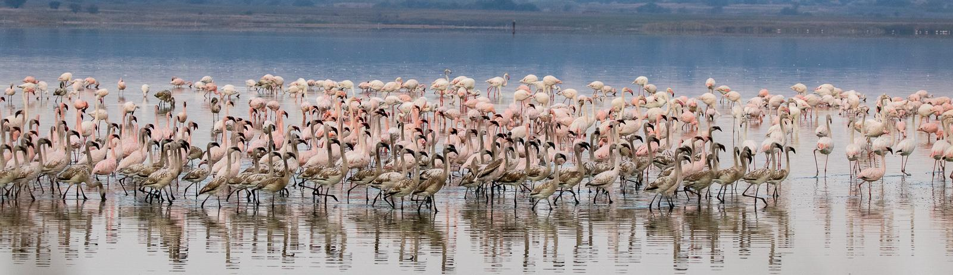
A data pipeline for wetlands and waterbirds
Photo: Doug Harebottle

Slide 5
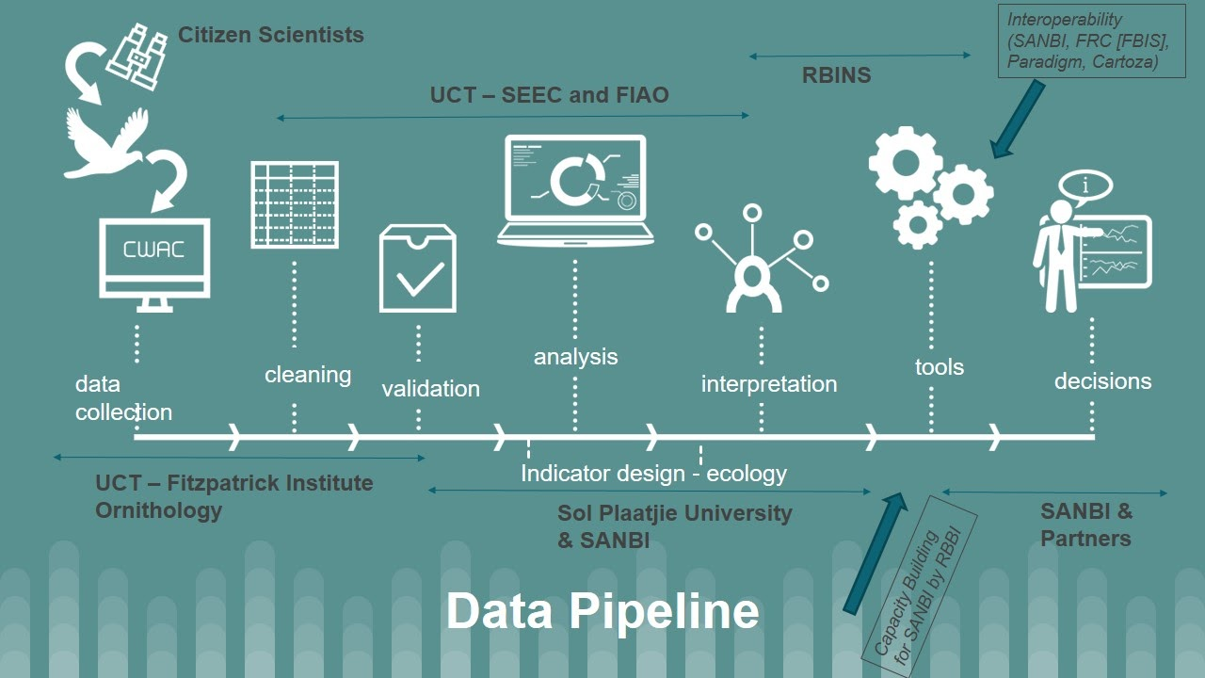
BIRDIE

Slide 6

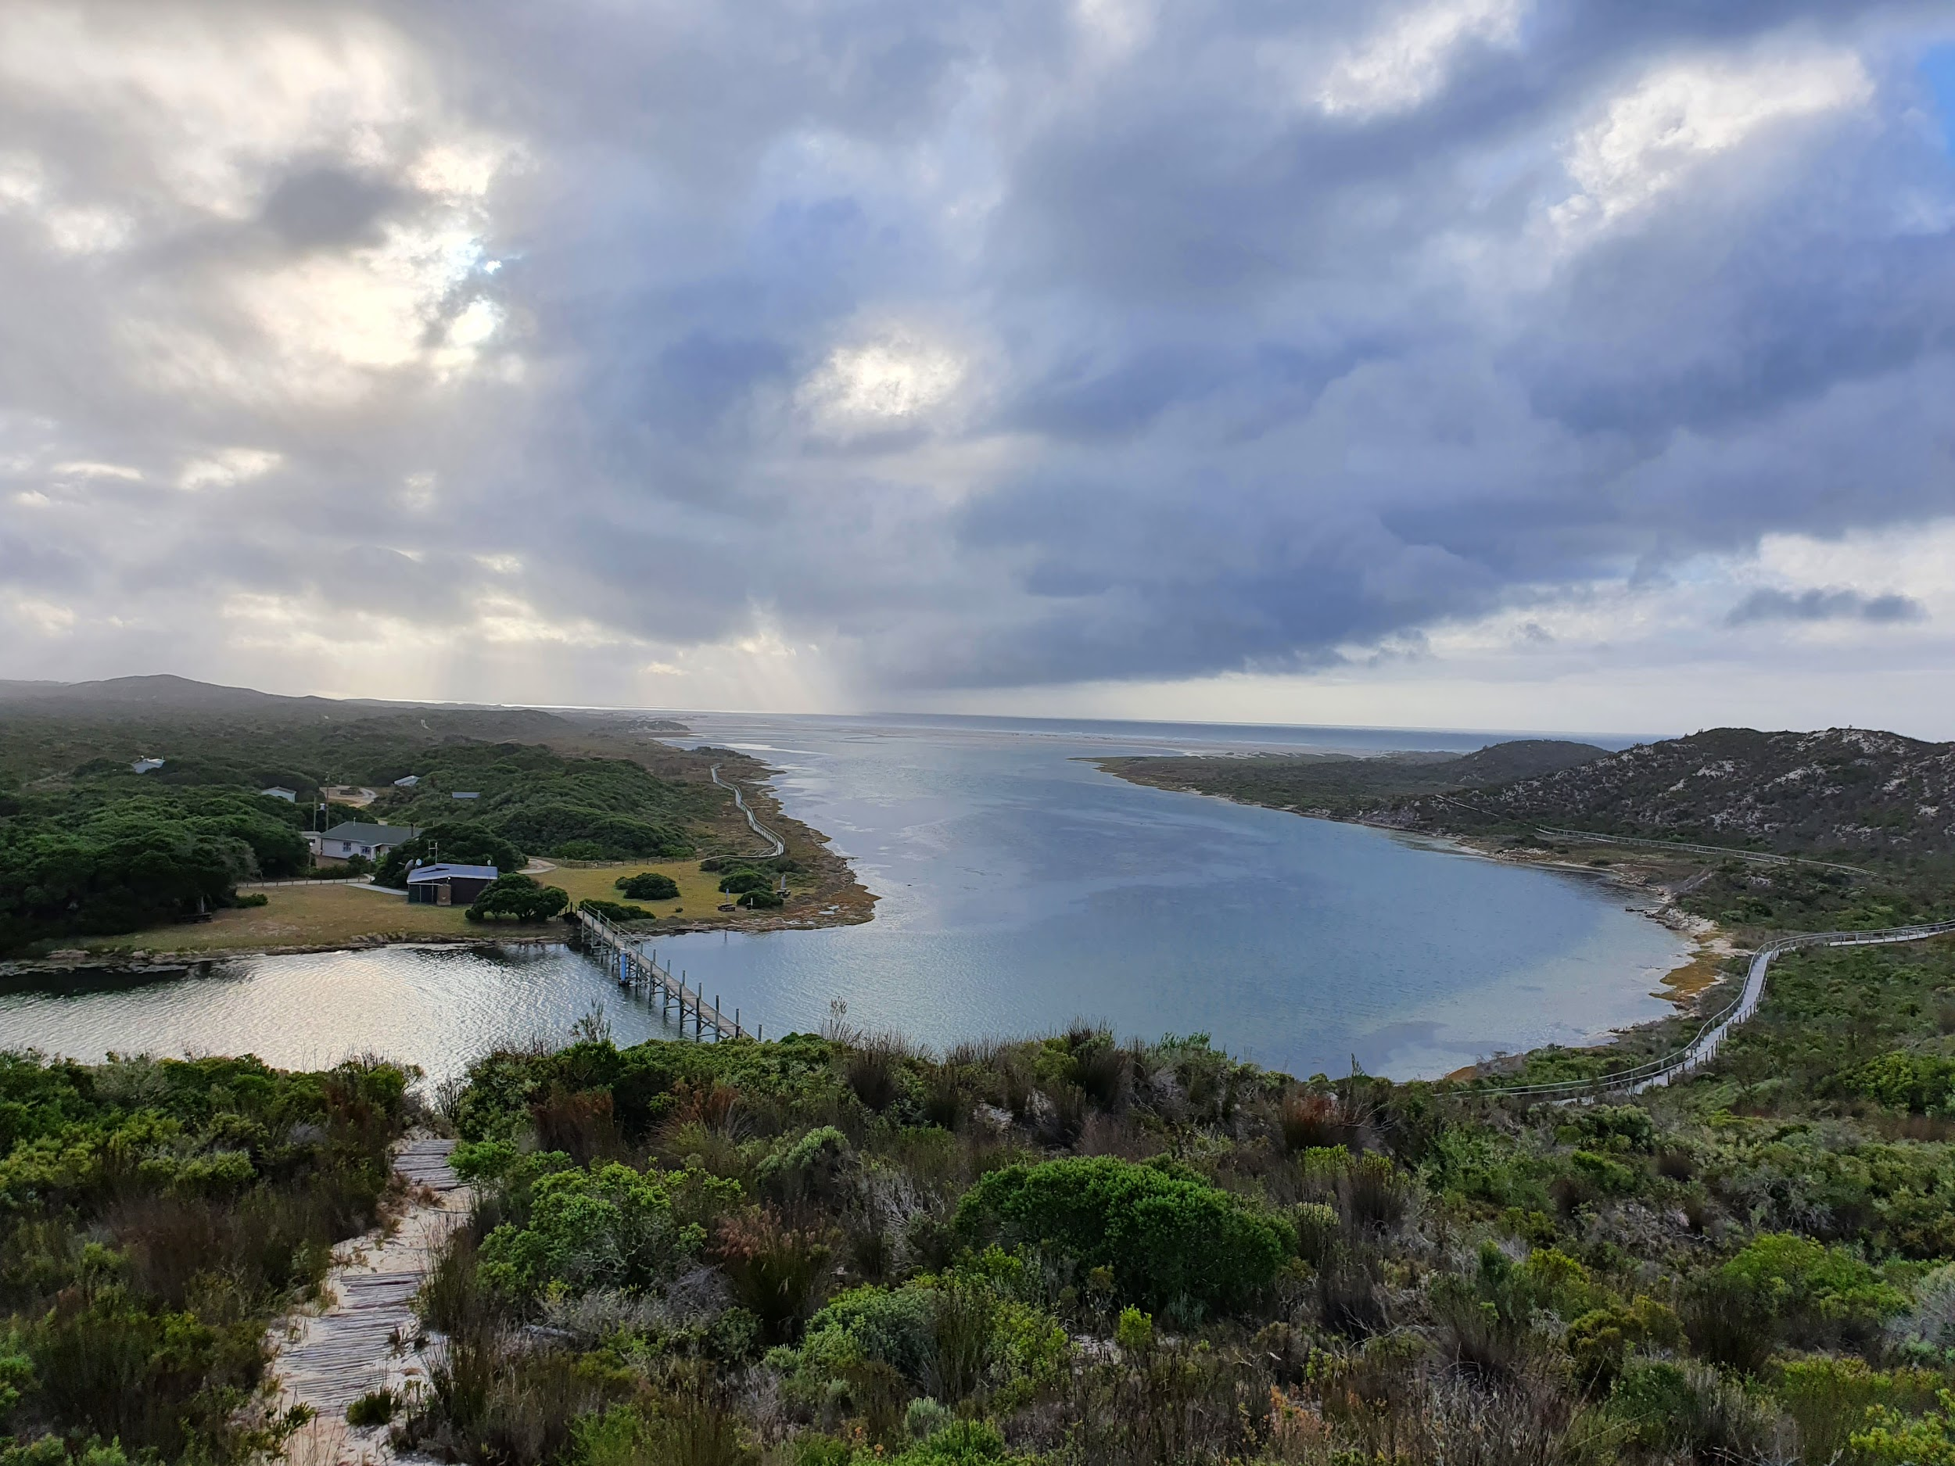
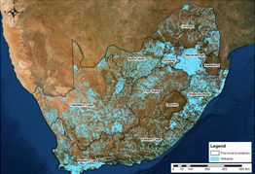


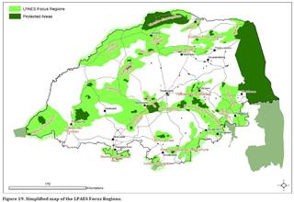

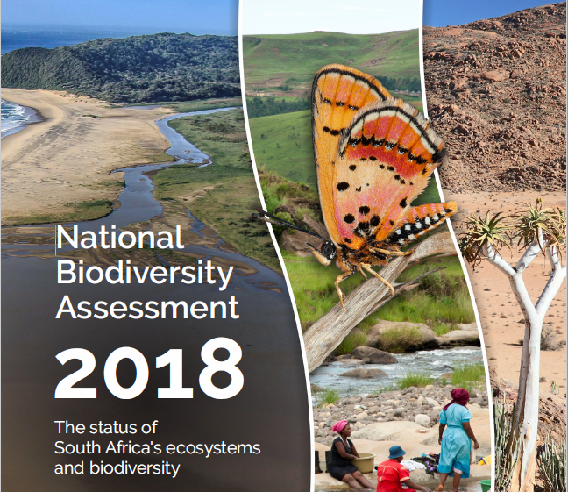


Research
International agreements
Site management
Policy
Citizen science
National and local reporting
Data capture and recreation
Data
Indicators
Decisions

Slide 7
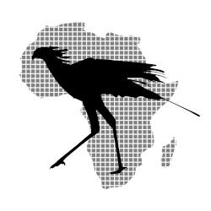
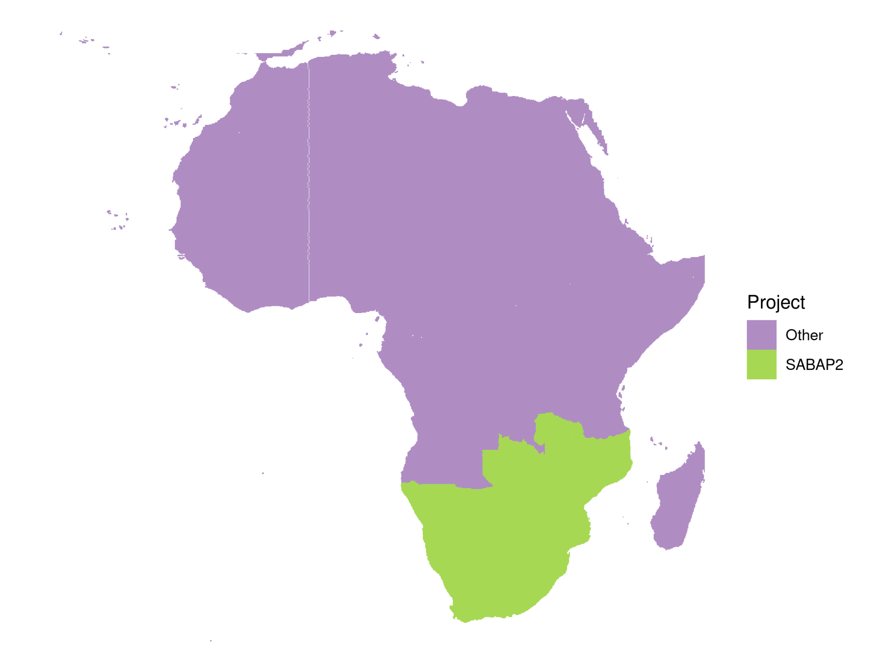
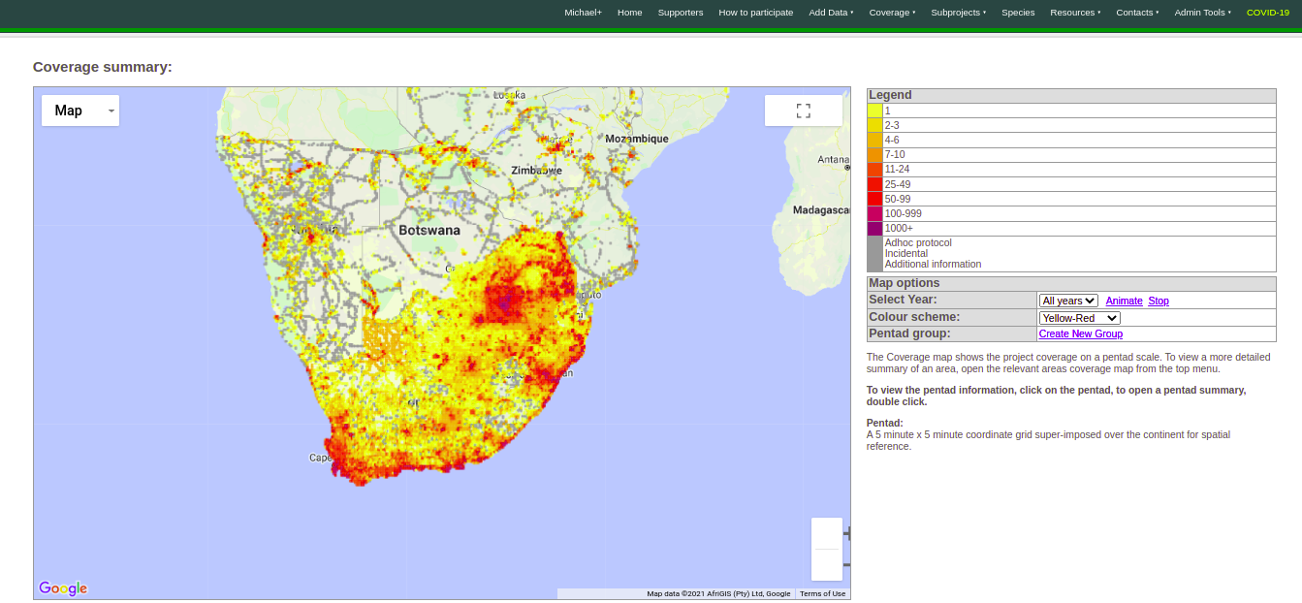
Southern African Bird Atlas Project
2007-ongoing
Detection/non-detection
~17.6 million records
14061 of 16708 pentads (5’ x 5’)

Slide 8
Southern African Bird Atlas Project
2007-ongoing
Detection/non-detection
~17.6 million records
14061 of 16708 pentads (5’ x 5’)
Now also in R!
https://github.com/AfricaBirdData/ABAP

Slide 9
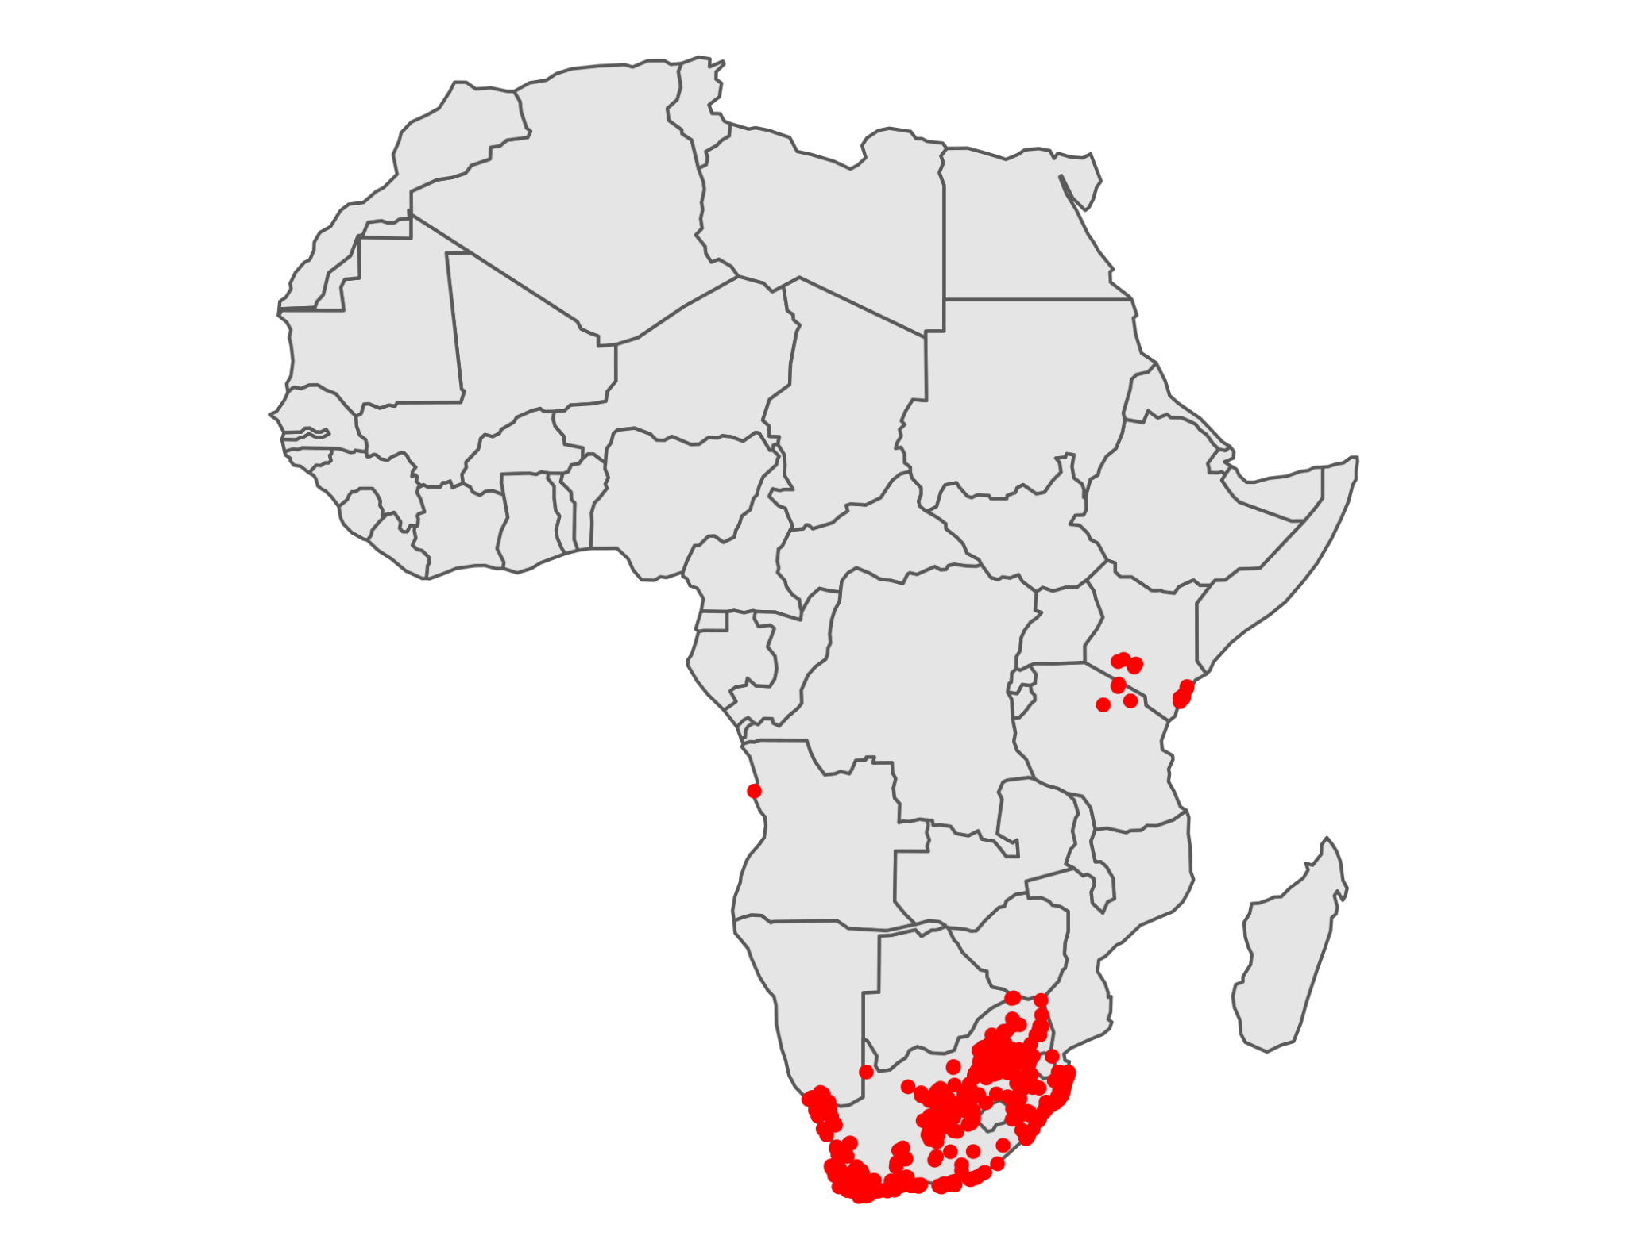
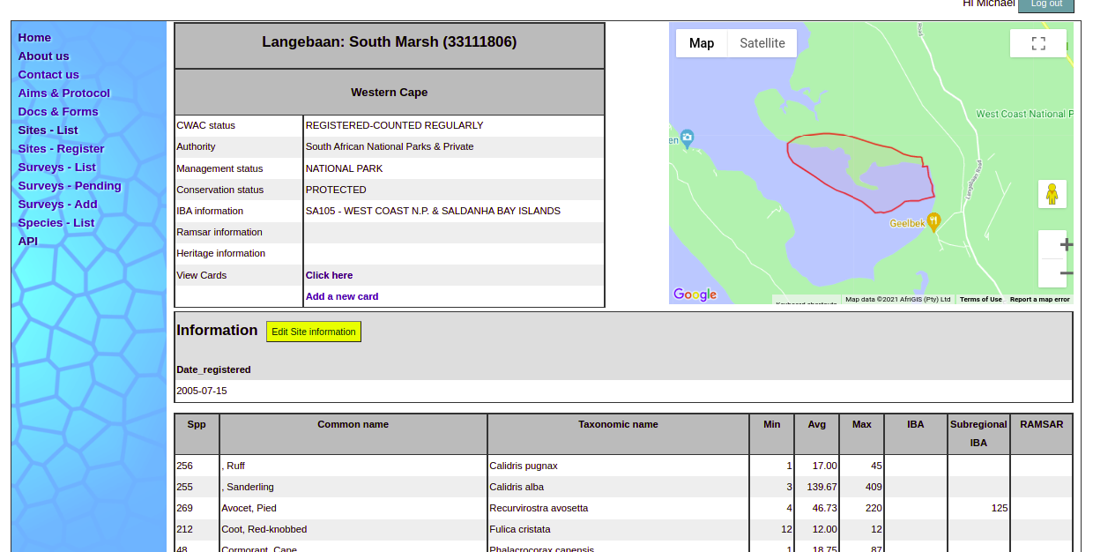
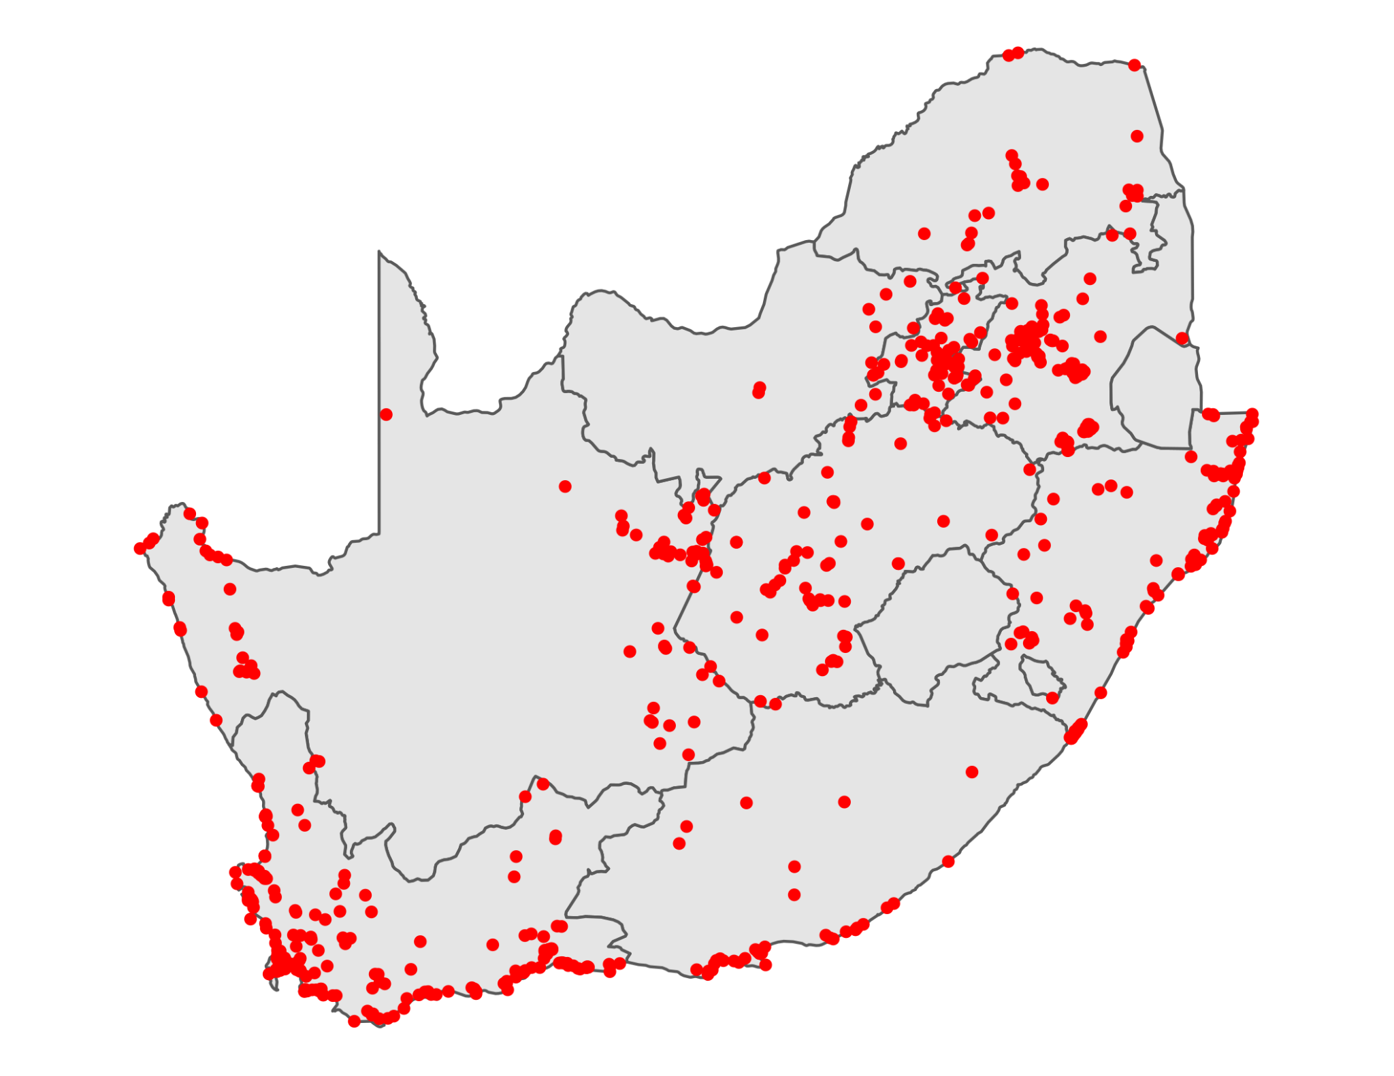
Coordinated Waterbird Counts
1992-ongoing
Abundance
~347,000 records
739 sites

Slide 10
Coordinated Waterbird Counts
1992-ongoing
Abundance
~347,000 records
739 sites
Now also in R!
https://github.com/AfricaBirdData/CWAC

Slide 11
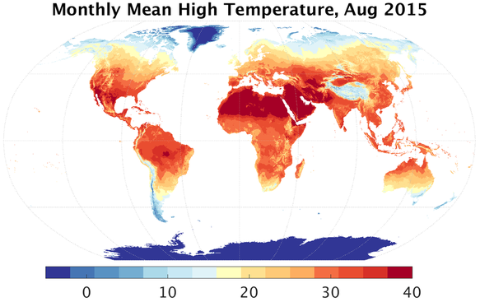
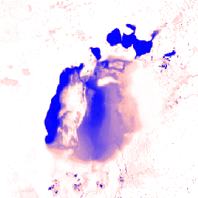

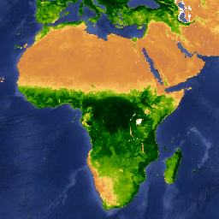
Supporting information
TerraClimate
JRC surface water
MODIS veg. indices
Wetland inventory

Slide 12
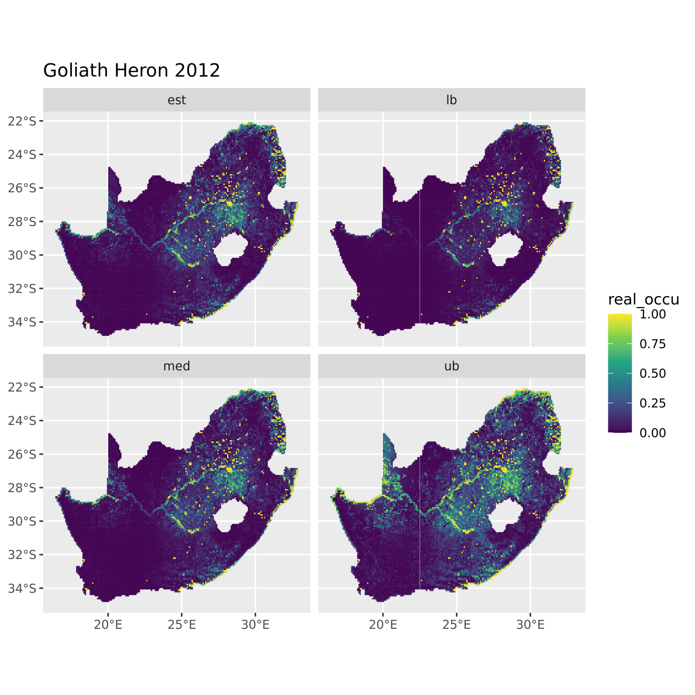
Species distribution
Estimate
Lower bound
Occupancy models for ABAP
Bayesian framework
Occupancy per pentad, year and species
Derived indicators:
Area of occupancy
Extent occurrence
…
Median
Upper bound

Slide 13
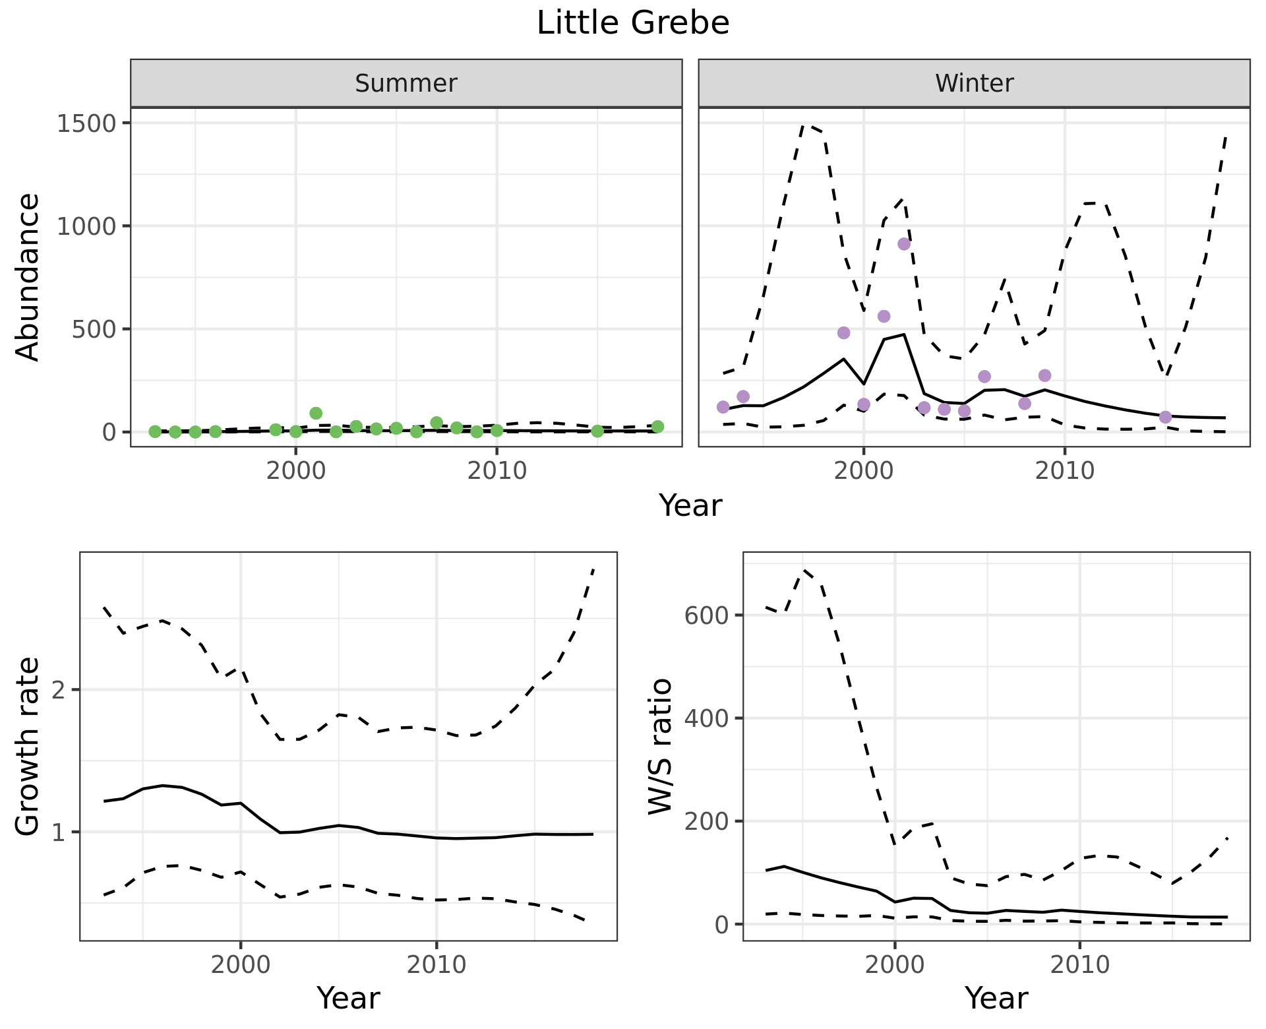
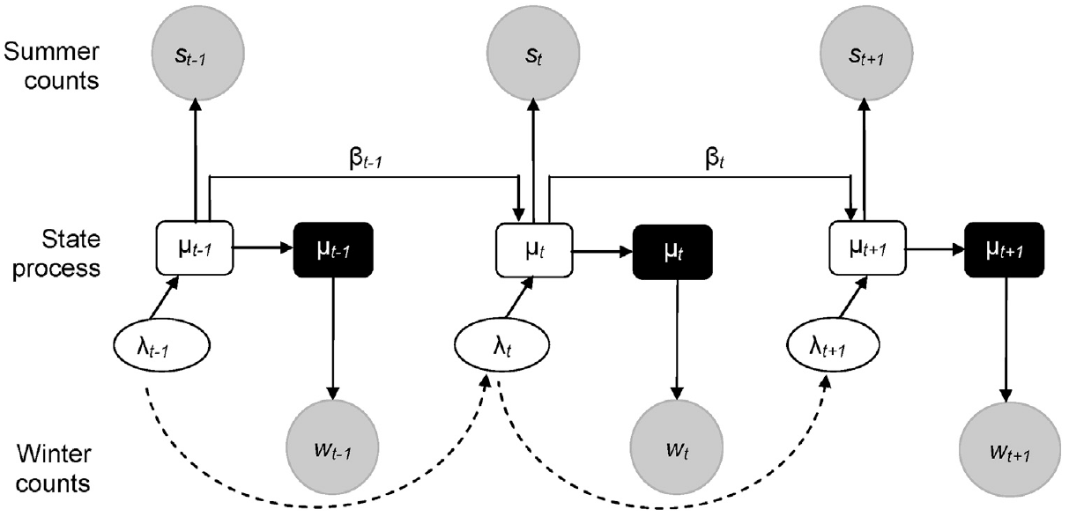
Species abundance
State-space model for CWAC
Bayesian framework
Species- and site- specific models
Aggregate results to obtain abundance at larger scales
Barshep et al. 2017, Global Eco. and Con. 12

Slide 14
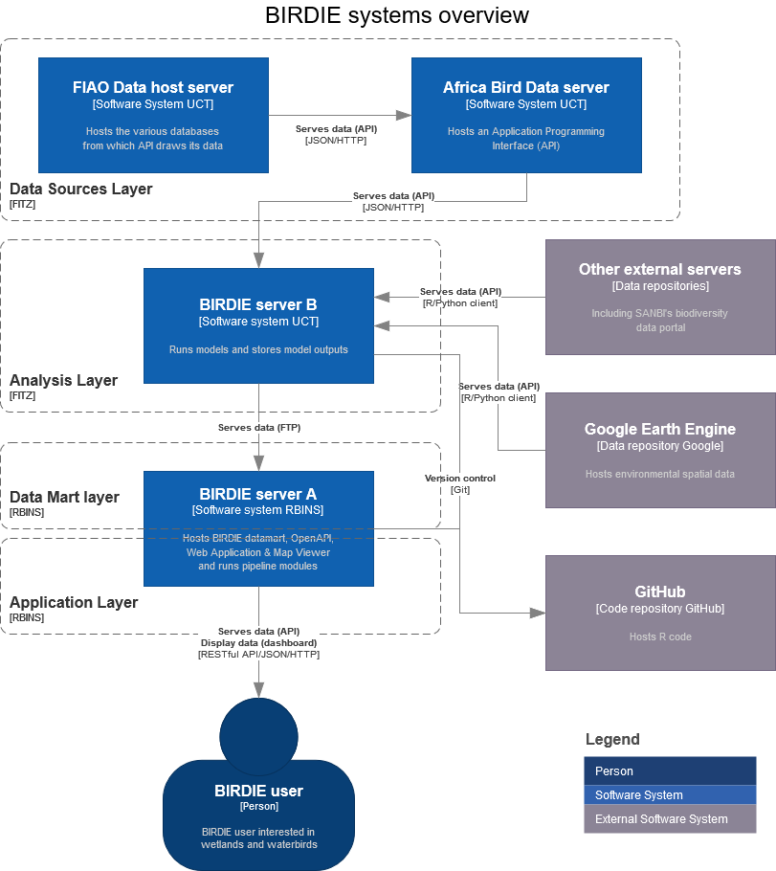
Data server
Analysis
Support
Presentation
Decisions

Slide 15
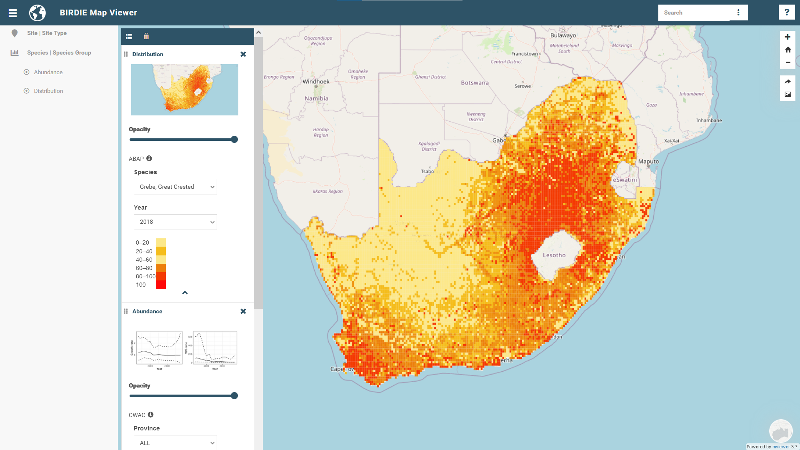

Slide 16
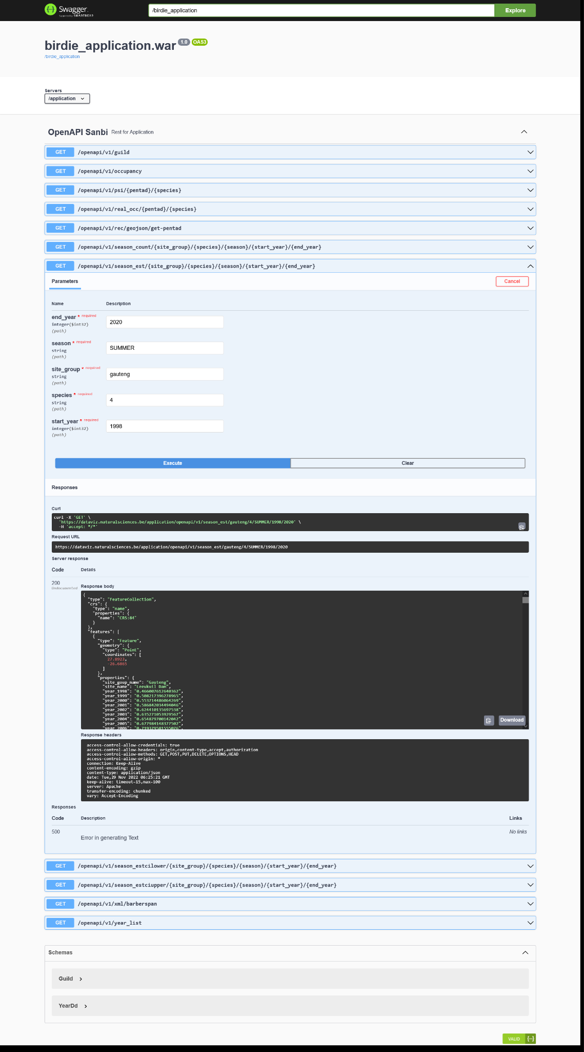

Slide 18


Thank you!
Carol Poole (SANBI)
Nancy Job (SANBI)
Andrew Skowno (SANBI)
Sediqa Khatieb (SANBI)
Doug Harebottle (Sol Plaatje University)
Michael Brooks (FIAO UCT)
Res Altwegg (SEEC UCT)
Vernon Visser (SEEC UCT)
Francis Strobbe (RBINS)
Yvan Stojanov (RBINS)
…
CC-BY
https://github.com/AfricaBirdData

